Slide 1
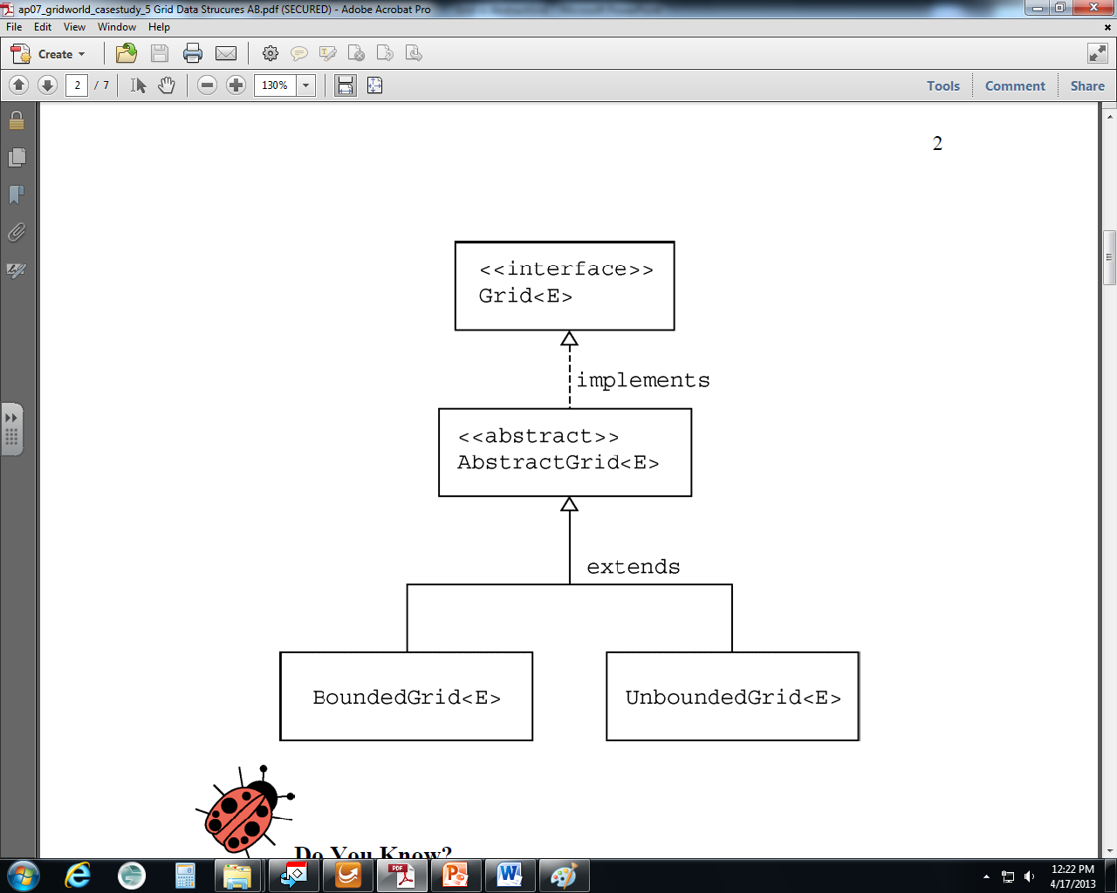

Slide 2
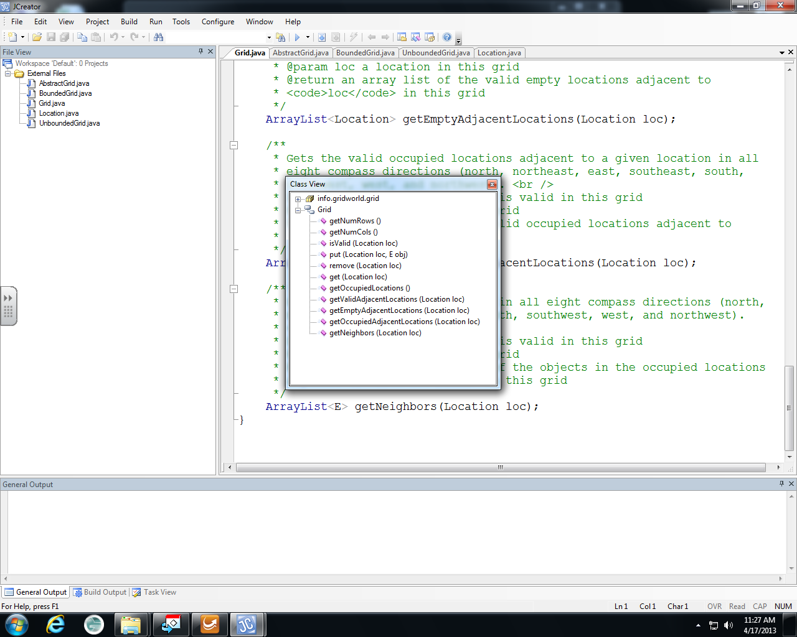
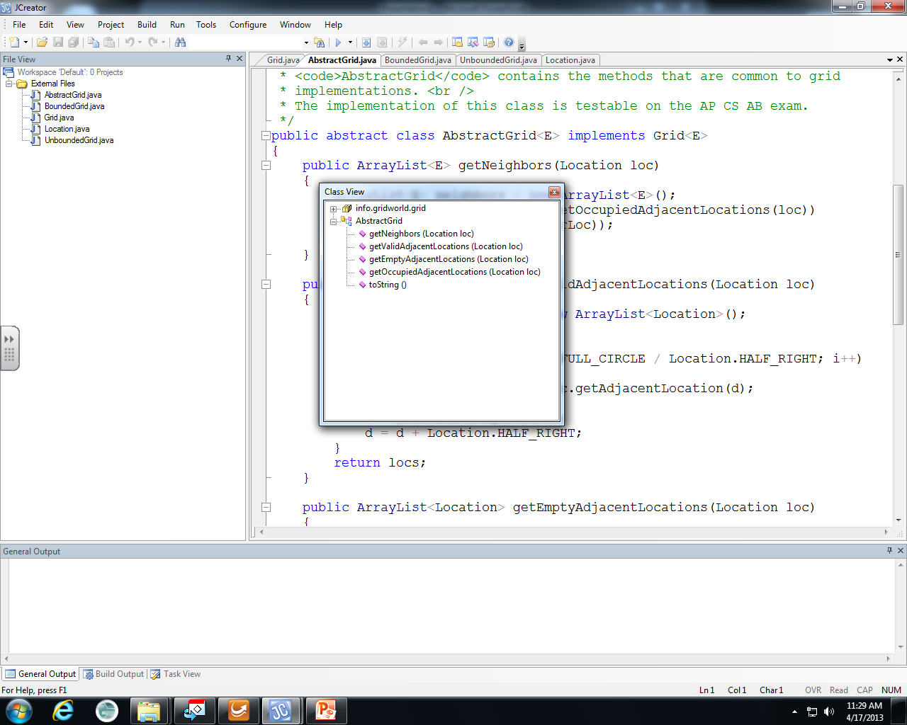
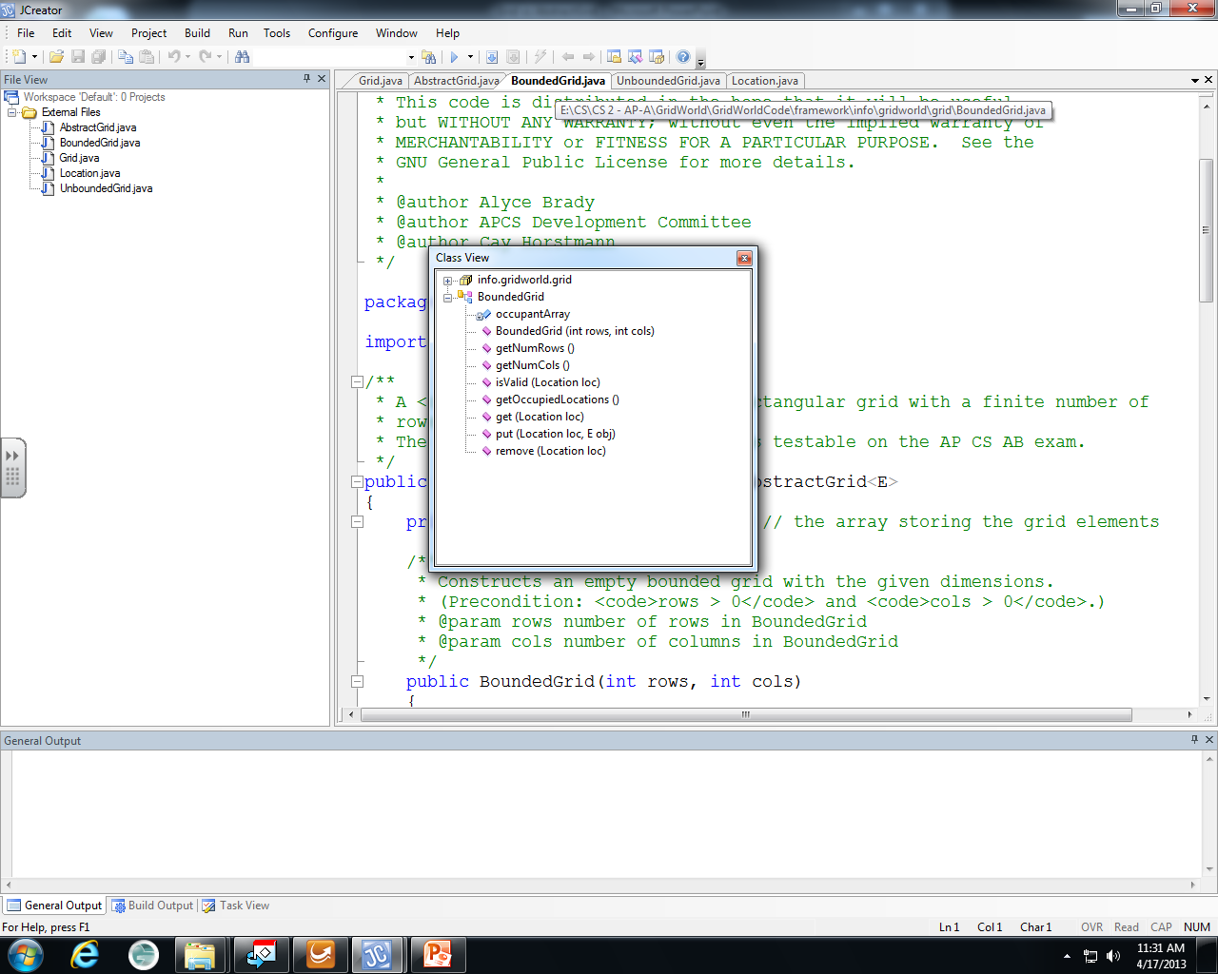
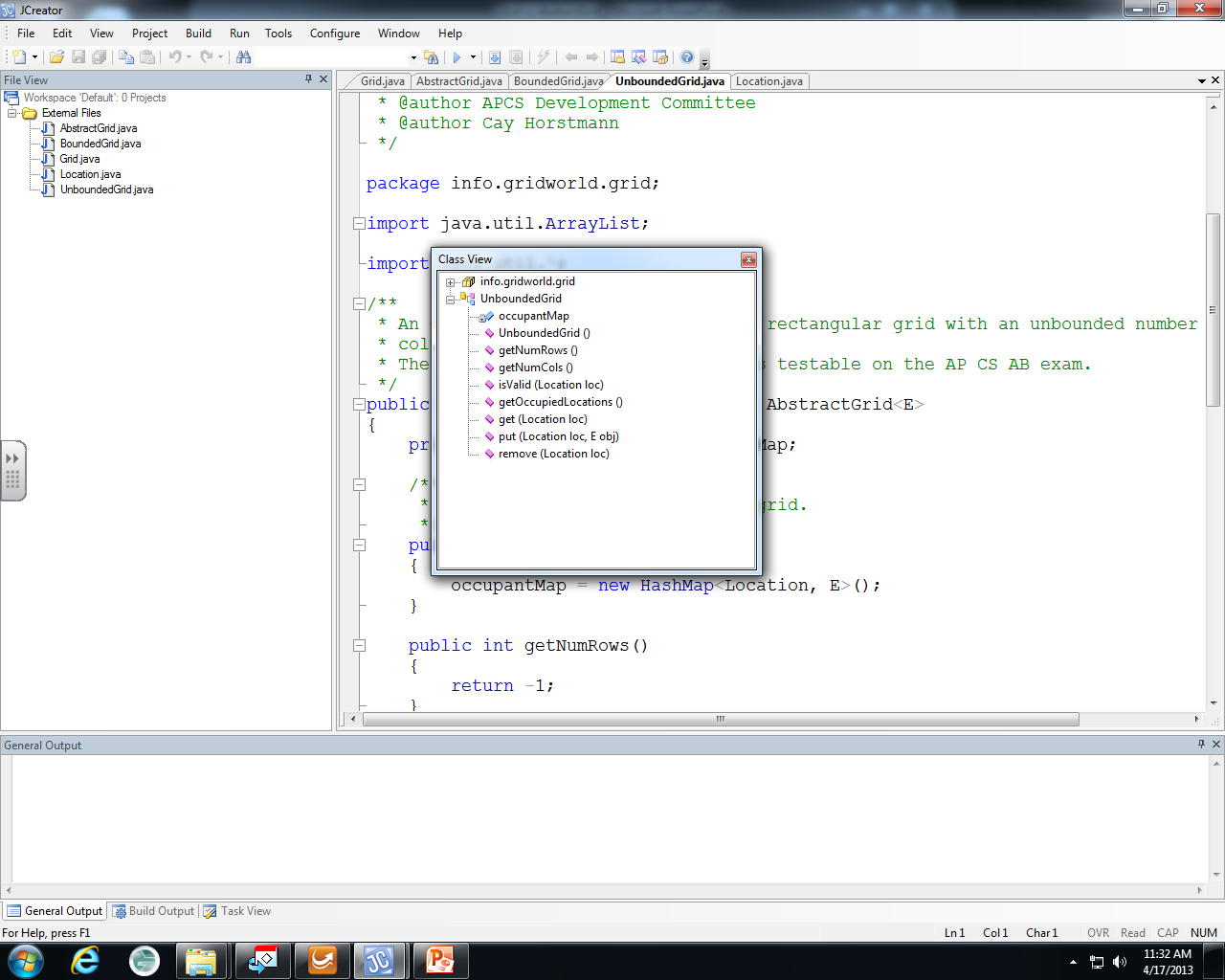

Slide 4
Grid
interface
AbstractGrid
abstract class

Slide 5
Grid
interface
BoundedGrid
concrete class

Slide 6
Grid
interface
UnboundedGrid
concrete class

Slide 7
Grid
interface
AbstractGrid
abstract class
BoundedGrid
concrete class
UnboundedGrid
concrete class

